Slide 1

Team Details
Titans
Vinay Purilla
Wildfire Detection System with TSP Algorithm and Real-time Alerts

Slide 2

Brief about the idea
Our idea is mainly concerned with detection of wildfire in the forest that causes a great damage to the both
Economy,environment and biodiversity.
Objective: To detect wildfires in forests using the YOLOv9 model and optimize resource deployment using the Traveling Salesman Problem (TSP) algorithm, with a mapping interface for visualization.
Components:
Wildfire Detection:
Model: YOLOv9
Purpose: Identify wildfire signs in images or video footage.
Resource Optimization:
Algorithm: Traveling Salesman Problem (TSP)
Purpose: Determine the shortest path for firefighting resources to reach detected wildfire locations.
Mapping Integration:
Purpose: Visualize wildfire locations and optimized routes on a map.
Outcome: Efficient detection and management of wildfires, minimizing damage to the economy, environment, and biodiversity through optimized resource deployment and real-time mapping.

Slide 3
Opportunities
How different is it from any of the other existing ideas?
How will it be able to solve the problem?
USP of the proposed solution
Opportunities & USP
Differentiation:
Integrated Solution: Combines YOLOv9 for accurate wildfire detection with TSP for optimized resource deployment.
Real-Time: Provides immediate detection and optimized routes, enhancing traditional methods.
Advanced Mapping: Merges detection and TSP results with a mapping interface for comprehensive visualization.
Problem Solving:
Early Detection: YOLOv9 enables fast and accurate wildfire identification.
Optimized Response: TSP algorithm ensures efficient firefighting resource deployment.
Enhanced Decision-Making: Mapping interface offers real-time visualization of wildfires and routes.
USP:
Holistic Approach: Combines detection, optimization, and visualization in one system for superior wildfire management.

Slide 4
List of features offered by the solution
Features
Real-Time Wildfire Detection
YOLOv9 Model: High-accuracy detection of wildfire signs from images or video.
Optimized Resource Deployment
TSP Algorithm: Calculates the shortest path for firefighting resources to reach wildfire locations efficiently.
Dynamic Mapping Integration
Interactive Maps: Displays detected wildfires and optimized routes with real-time updates.
Enhanced Visualization
Bounding Boxes & Timestamps: Visualizes detected fire areas with clear annotations and time data.
Efficient Resource Allocation
Route Optimization: Provides optimal paths for resource deployment, reducing response times.
User-Friendly Interface
Map Interface: Easy-to-use interface for viewing wildfires and planning response strategies.
Comprehensive Data Integration
Detection & Mapping: Combines detection results with mapping for a complete wildfire management solution.

Slide 5
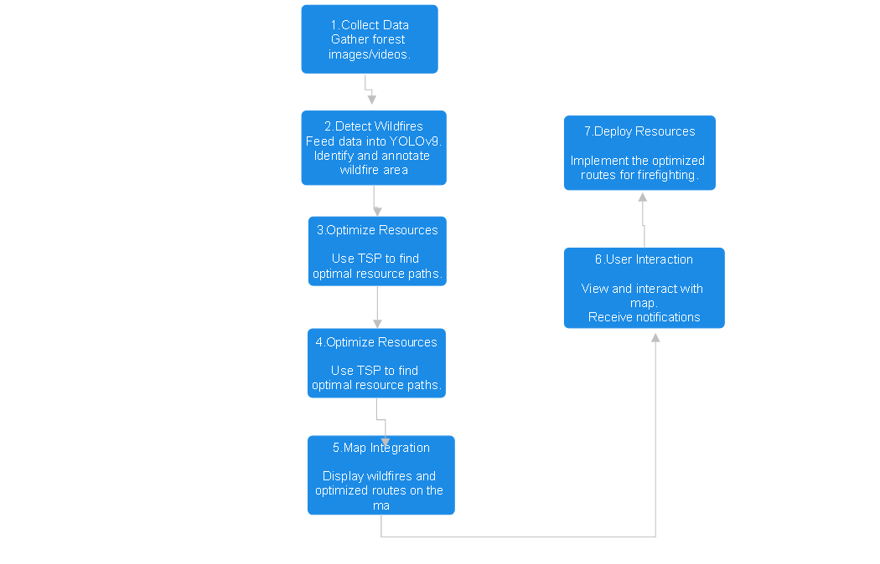
Process flow diagram or Use-case diagram

Slide 6
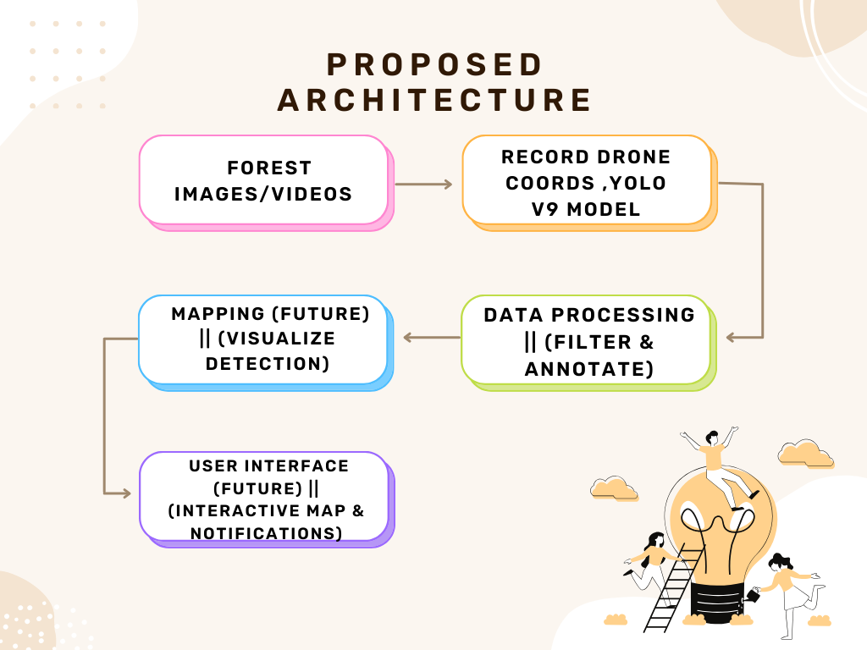
Architecture diagram of the proposed solution

Slide 7
Technologies to be used in the solution
Object Detection:
YOLOv9: For real-time wildfire detection and bounding box generation.
Optimization Algorithm:
Traveling Salesman Problem (TSP) Solver: For calculating optimal resource paths.
Mapping:
Mapping Services: Google Maps, Leaflet, or OpenStreetMap for visualizing detected wildfires and optimized routes.
Programming Languages:
Python: For implementing YOLOv9, TSP optimization, and data processing.
GIS Tools (Optional for Mapping):
Geographical Information System Tools: For handling spatial data and analysis if needed.

Slide 8
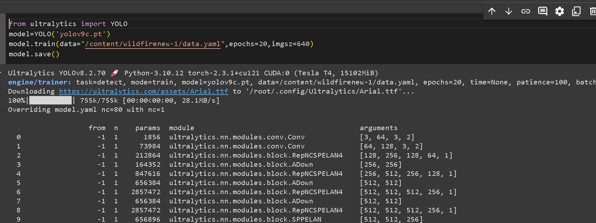
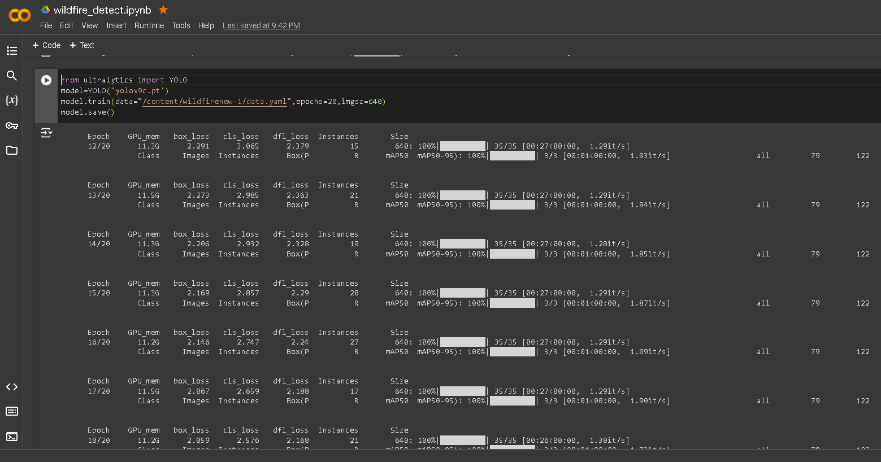
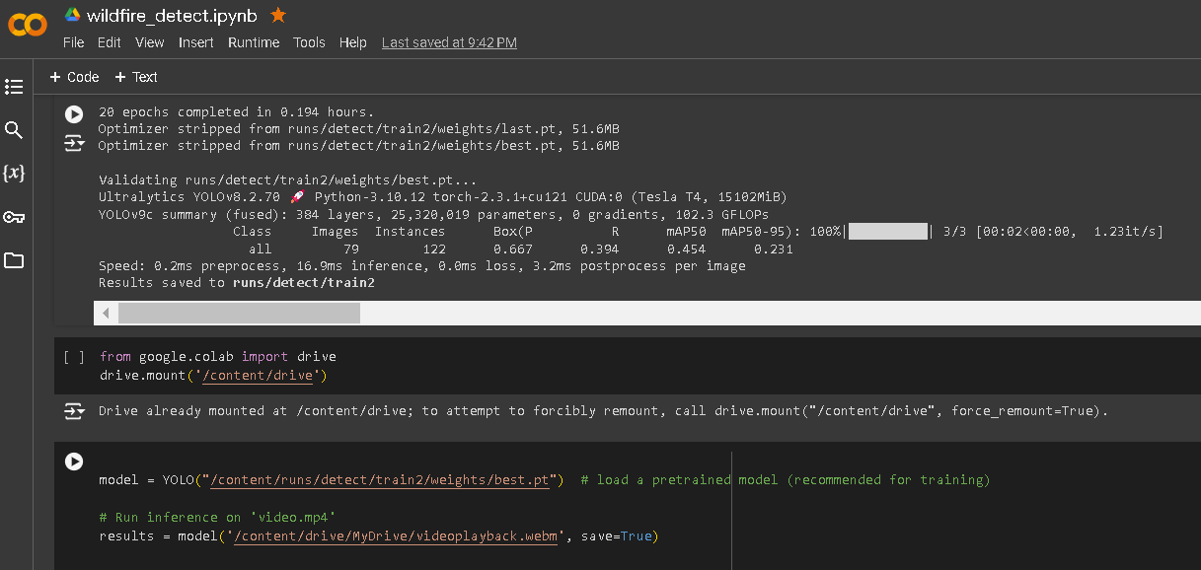
Snapshots of the prototype

Slide 9
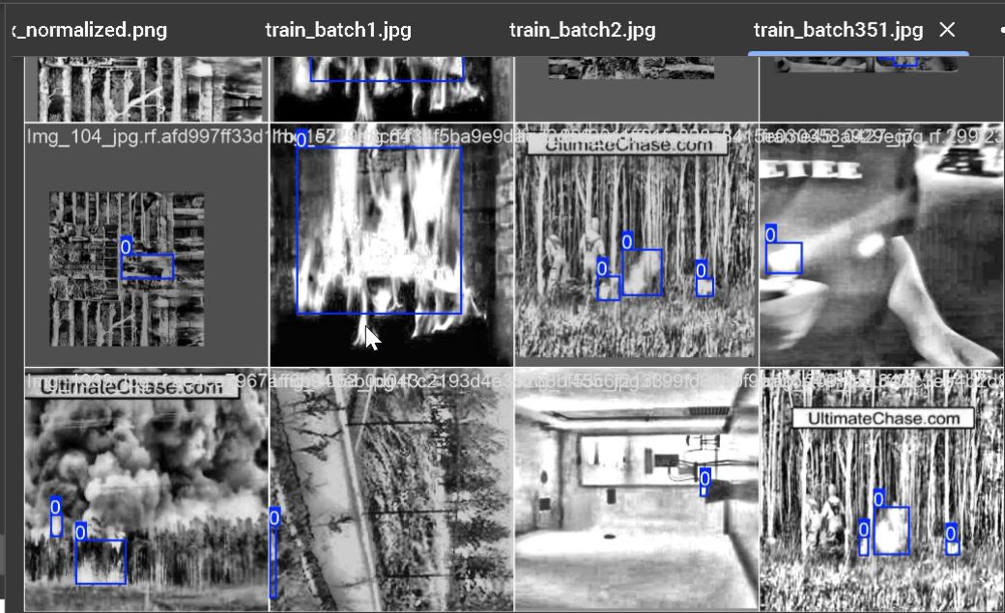
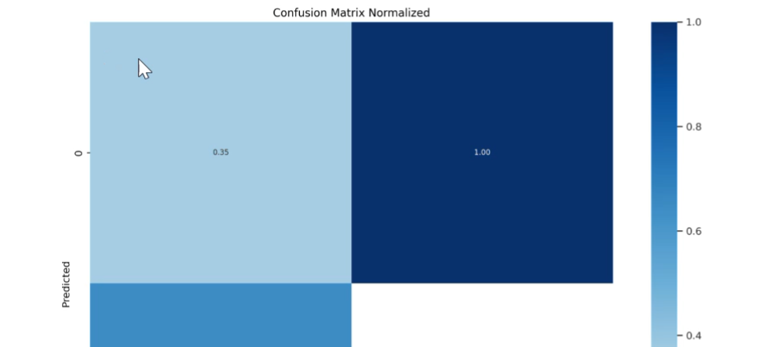
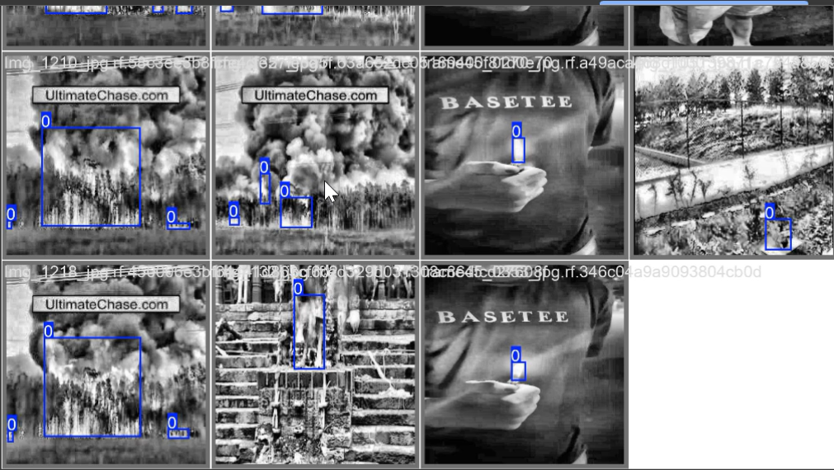
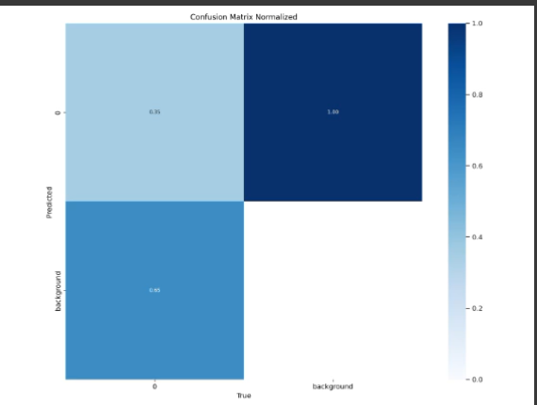
Prototype Performance report/Benchmarking

Slide 10
GitHub & Demo video URL
Github repo url: https://github.com/vinayp1120/FIRE_DETECTION
Video Url: https://youtu.be/iNeCP2Ti4kc

Slide 11


